Slide 1


Slide 2

Introduction to
Data Science
(IT4142E)

Slide 3
Contents
Lecture 1: Overview of Data Science
Lecture 2: Data crawling and preprocessing
Lecture 3: Data cleaning and integration
Lecture 4: Exploratory data analysis
Lecture 5: Data visualization
Lecture 6: Multivariate data visualization
Lecture 7: Machine learning
Lecture 8: Big data analysis
Lecture 9: Capstone Project guidance
Lecture 10+11: Text, image, graph analysis
Lecture 12: Evaluation of analysis results

Slide 4
POS Tagging
PennTreebank
Hidden Markov model
Evaluation

Slide 5
POS tagging PennTreebank
Created by University of Pennsylvania
Eight-years project: 1989 – 1996
7 millions words of POS tagged texts
POS tagset is based on Brown Corpus

Slide 6
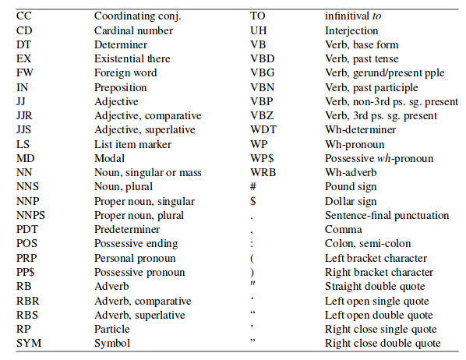
POS tagging PennTreebank

Slide 7
POS tagging PennTreebank
CC
He bought a car and a house.
CD
Five years later, autocar will be popular.
DT
Pierre Vinken will join the board.
EX
There is no asbestos in our product now.

Slide 8
POS tagging PennTreebank
IN
Mr Vinken is chairman of Elsevier N.V.
JJ
Rudolph Agnew was named an executive director.
JJR
The number of death was higher than expected

Slide 9
POS tagging PennTreebank
JJS
The percentage of lung cancer appears to be highest.
MD
US should regulate the class of asbestos.
NN
It’s more than three times the expected number.
NNS
Portfolio managers expect further declines in interest rates.

Slide 10
POS tagging PennTreebank
NNP
Alexis Sanchez joined Manchester United yesterday.
NNPS
… the Japan Automobile Dealers’ Association...
POS
… at Monday’s auction

Slide 11
POS tagging PennTreebank
PRP
It expects to obtain regulatory approval.
PP$
Shareholders approve its acquisition by Royal Trustco Ltd.
RB
… depends heavily on creativity
RBR
… worked for the project for more than six years

Slide 12
POS tagging PennTreebank
RBS
the most mundane aspect of its workers
TO
He decided to stay

Slide 13
POS tagging PennTreebank
VB
… to return home
VBD
the executives joined Mayor William
VBG
… before boarding the buses again
VBN
A buffet breakfast was held in the museum

Slide 14
POS tagging PennTreebank
VBP
Plans that give advertisers disscount
VBZ
The plan is not an attempt
WDT
a project that did not include Seymor
WP
who couldn’t be reach for comment

Slide 15
POS tagging PennTreebank
WRB
where employees are assigned lunch partners

Slide 16
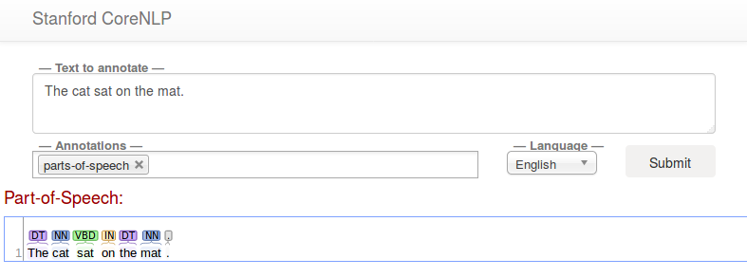
corenlp.run

Slide 17
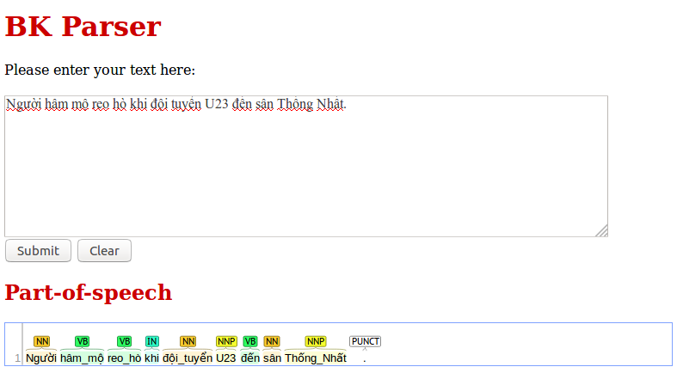
http://45.117.171.213/bknlptool/

Slide 18

POS tagging Hidden Markov Models
DT
NN
VBD
IN
DT
NN
The
cat
sat
on
the
mat

Slide 19
POS tagging Hidden Markov Models
Transition probability
Pr(x_{t} = NN | x_{t-1} = DT)
Emission probabitlity
Pr(o_{t} = cat | x_{t} = NN)

Slide 20
POS tagging Hidden Markov Models
Unsupervised parameter learning with MLE
argmax_{theta} Pr(O, X | theta)
Baum–Welch algorithm
Decoding:
argmax_{X} Pr(X | theta, O)
Viterbi algorithm

Slide 21

POS tagging Baum-Welch algorithm
E step
Forward phase
Backward phase
`

Slide 22
POS tagging Baum-Welch algorithm
M step

Slide 23
POS tagging Viterbi decoding

Slide 24
POS tagging Viterbi decoding
argmax_{X} P(X | O, theta)
The
cat
sat
on
the
mat
DT
DT
DT
DT
DT
DT
<S>
IN
IN
IN
IN
IN
IN
<E>
NN
NN
NN
NN
NN
NN
VBD
VBD
VBD
VBD
VBD
VBD
...
...
...
...
...
...

Slide 25
POS tagging Viterbi decoding
argmax_{X} P(X | O, theta)
The
cat
sat
on
the
mat
DT
DT
DT
DT
DT
DT
<S>
IN
IN
IN
IN
IN
IN
<E>
NN
NN
NN
NN
NN
NN
VBD
VBD
VBD
VBD
VBD
VBD
...
...
...
...
...
...

Slide 26
POS tagging Supervised paramter estimation
Transition probability
Pr(x_{t}=NN|x_{t-1}=DT)
Emission probabitlity
Pr(o_{t}=cat|x_{t}=NN)
Supervised parameter estimation
Pr(x_{t}=NN|x_{t-1}=DT)=(count(DT,NN)+1)/(count(DT)+L)
Pr(o_{t}=cat|x_{t}=NN)=(count(cat,NN)+1)/(count(NN)+V)

Slide 27
POS Tagging Evaluation
Comparing system output with golden annotations
Datasets:
Train: Used to train taggers
Dev: Used to tune hyper-parameters
Test: Used to test models

Slide 28
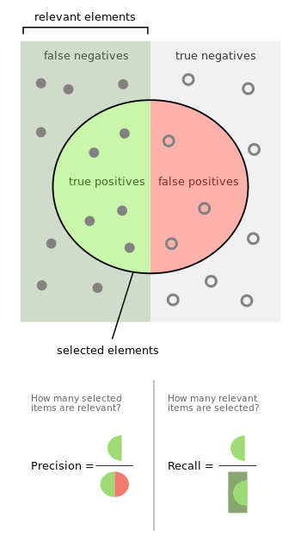
POS Tagging Evaluation
Precision
Recall
F₁ = 2PR / (P+R)

Slide 29

Thank you for​ your attentions!​

